Slide 1

Volunteering And Donation Project
“Connecting Hearts and Hands”
Labanya Saha(21201059)
Paria Chowdury(21201067)
Group members:
Tamanna Akter Toma(21201074)

Slide 2

OUR OUTLINE:
PROJECT DEFINATION
ABOUT
OBJECTIVE
PROJECT OVERVIEW
MAIN FREATURES
PROBLEM STATEMENT
MOTIVATION
SOLUTION
USING LANGUAGE

Slide 3
Problem Defination
“Connecting Hearts and Hands” is a web platform that links charitable organizations with volunteers and donors. It streamlines managing volunteer activities, donation transactions, and communication, making it easier for people to contribute and for organizations to coordinate support.

Slide 4

ABOUT
Connecting Hearts and Hands is a Volunteering and Donation Management System connects charitable organizations with individuals eager to support community initiatives. It empowers people to donate money, goods, or time through a centralized platform, efficiently managing volunteering and donations. This project enhances non-profits’ effectiveness by streamlining interactions with volunteers and donors, simplifying event, task, and contribution coordination.
We believe in the power of collective action and the
importance of every contribution, big or small.

Slide 5





PROJECT OVERVIEW
Donation Drives:
We facilitate regular donation drives to
collect essential items such as food,
clothing, school supplies, and hygiene products,
which are distributed to families and individuals in need.
Volunteer Programs
We organize a variety of volunteer opportunities.

Slide 6



OBJECTIVE
Set up a secure and user-friendly system for online donations
Beautiful platform
Users gets satisfied
Always updating
Voluteer activity
and ensure
donare that their
donation come to
needy people

Slide 7
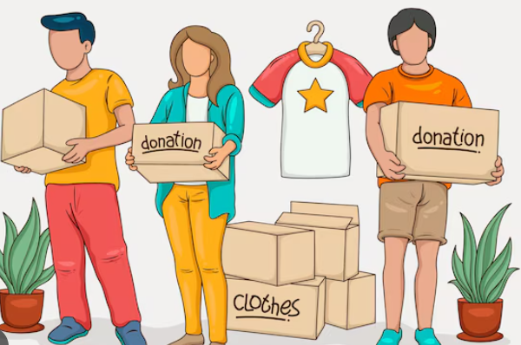
MAIN FEATURES
,
Authentication(Login,Registration),
Profile Management,
Admin Pannel,
Real-Time Notification and Updates,
Search Result,
Donation Management,
Confirmation Donor,
Career in Our Platform.

Slide 8

MOTIVATION
In today’s world, many people want to help their communities by volunteering or donating.
Ensuring accessibility for anyone
Personal Satisfaction
Social Connections
Coordination Challenges
Skill Development

Slide 9
PROBLEM STATEMENT
1)Donators many time can not find correct place for donation. They faces cheaters.
2)Volunteer do not able to connect with donators.
3)Many underprivileged communities struggle with poverty and lack access to basic necessities like food, clothing.
4)Volunteer do not able to take donator in short time
5)They do not find user friendly platform

Slide 10
SOLUTION
Verified Non-Profit Organizations, Transparent Donation Tracking.
Integrated Volunteer-Donor Collaboration, Task with Event Management.
Needs-Based Campaigns, Location-Based Matching.
Real-Time Notifications, Automated Donation Requests.
User-Friendly Interface.

Slide 11
USING LANGUAGE
01
02
03
04
PYTHON
PYTHON FRAMEWORK
DJANGO
BASIC SQL
HTML
05
06
07
CSS
JAVASCRIPT
OTHERS

